Slide 1
Introduction to Html
Tombola Academy

Slide 2
Some Basic Terminology
The Internet – The global network of interconnected networks. E.g. When we use our network to connect to Google when searching – we connect to Google’s network. This is via the Internet.
Website – A set of web pages, normally on a single domain (e.g. www.tombola.co.uk)
World Wide Web – Interconnected web pages, typically transferred on the Internet.
Important to get these right – working in a profession where these terms have a proper meaning. In everyday life people don’t use precisely.
Notes:
Don’t dwell on this – just introduce.

Slide 3
Getting a Webpage via the Internet
Tombola’s Network
2
The Internet
Google’s Network
1
3
Your Laptop
4
User Requests web page, the browser passes on request to The Internet.
The Internet infrastructure passes the request on to the server - if it exists.
The server receives the request and prepares the page to respond with - assuming it can - and responds with the page.
The Server sends the response across the Internet
The browser processes the response – Most of the time the page has other resources that needs to be downloaded – images and style sheets amongst other things. The browser requests these via the internet too and the page is rendered.
A protocol (agreed standard way of working ) is used to fetch the page – typically HTTP (HyperText Transfer Protocol) or HTTPS (S = secure). There is no permanent connection between the client (your laptop) and the server – this has important implications when writing web applications, but not something you need to worry about just yet.
Notes:
Again, don’t dwell…

Slide 4
How Is a page Created?

Slide 5
How is a Web Page Structured?
A webapage is just text (they can be written in notepad), but one that uses an agreed standard – HTML : HyperText Markup Language
HyperText: Text that is capable of linking through to other text, both internally or externally
Markup Language: A way of annotating text to add information such as structure and the hyperlinks themselves. HTML uses tags in angle brackets “<tag>content</tag>”: <title>This is a Title</title>
Notes:
The structure adds semantic information, i.e. meaning about the document. E.g. a heading tag defines a header on a page
This is important

Slide 6
Example Html: Hello World
<!doctype html>
<html>
<head>
<title>Hello World</title>
</head>
<body>
<p>Hello World</p>
</body>
</html>
Document Type Declaration
Head: Contains information about page
Title: Normally displayed in browser tab
HTML:
Root Tag
Body: Main Content
Paragraph
Notes:
Hello World traditional first piece of code written in a new language.
This is not the smallest possible document – just the smallest that shows some of the main features. We will cover tags later.
Create an html document &

Slide 7
Page Structure
Page structure is important
It provides meaning to the page
Google uses this meaning to work out what the page is about – it gives more weight to important words in a main heading than a paragraph
We hang the layout off the tags – all headings on a site will be styled more or less the same way.
We’ll take a look at a magazine and see how it is broken down.

Slide 8
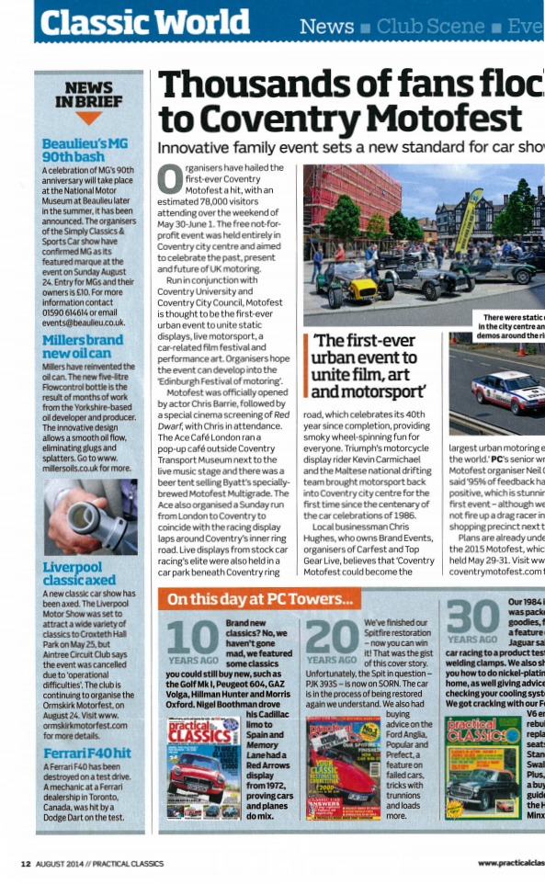
Example 1 – Magazine
Header
Basic Structure – Header, main body and footer
Main Body comprised
two articles
a sidebar
Main article comprised of:
Heading
Image
+ others e.g. sub-heading, paragraphs, figure caption
Rest of page also more complicated than shown here – can broken down further.
Article
Body
Heading
Image
Sidebar
Article
Footer

Slide 9
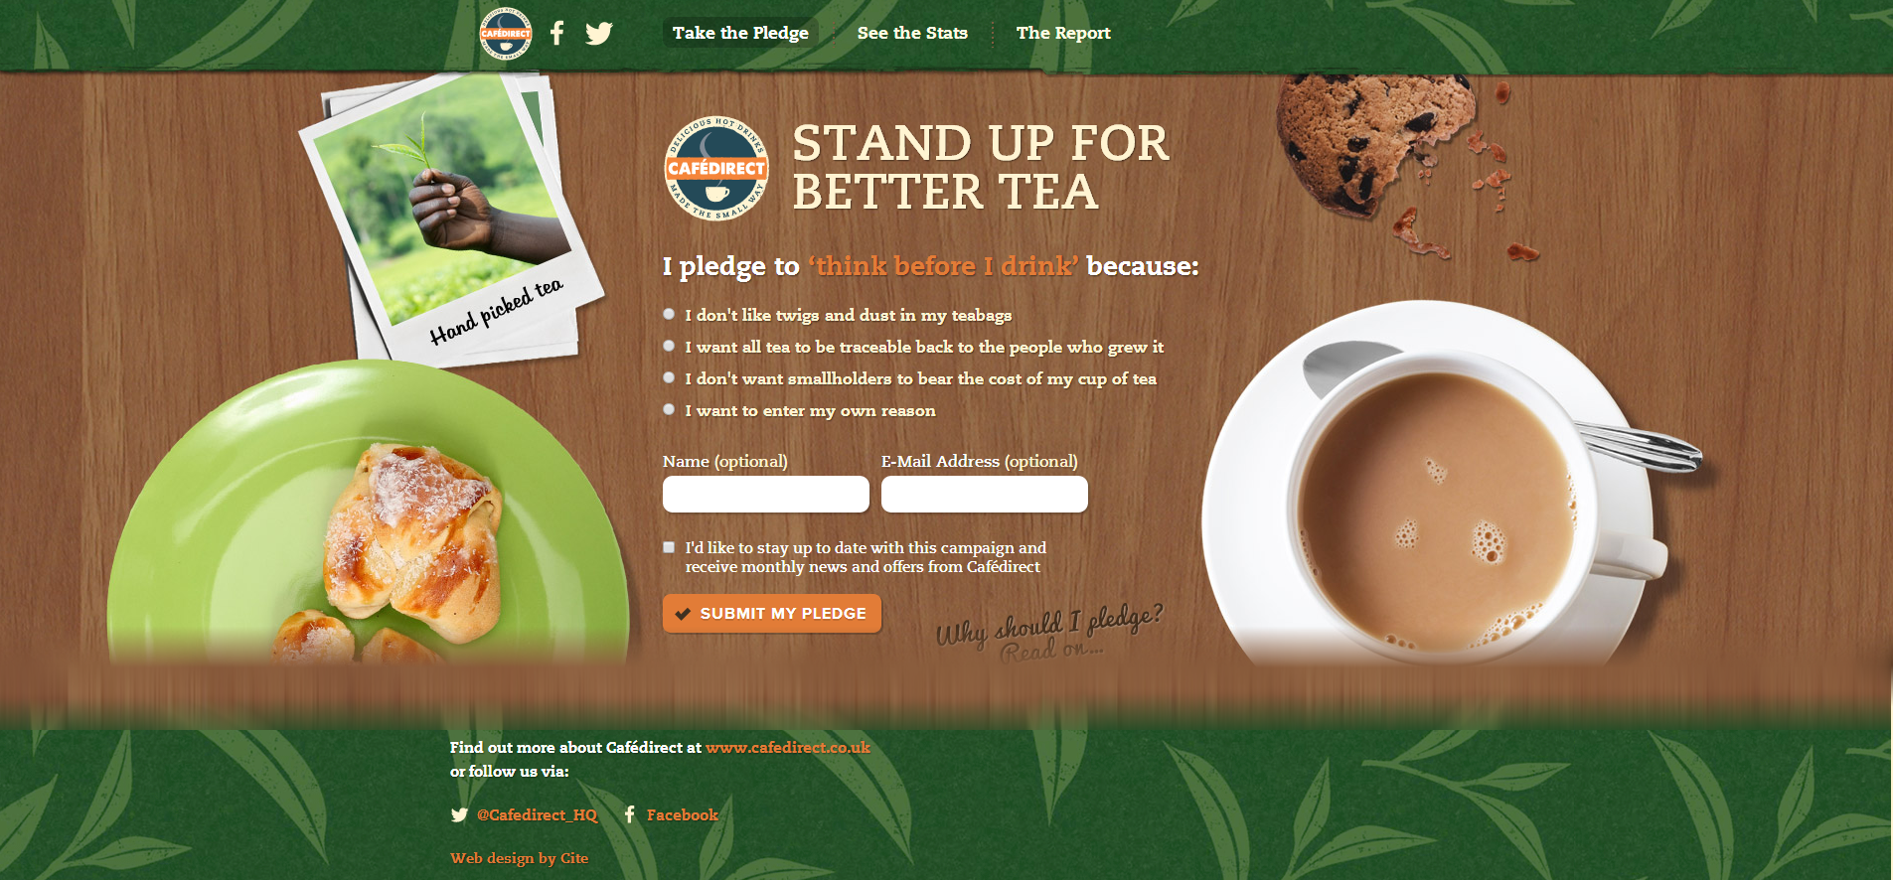
Example 2 – Actual Web Page
Header
Navigation
Main Body
Image
Heading
Sub-Heading
List
Form
Footer
Hyperlink
Same Basic Structure
Some elements same as print
Some new elements: some web-specific
Notes:
http://www.drinkbettertea.co.uk/
Been a long time since I heard anyone use hyperlink seriously – now just shortened to links.

Slide 10
Wasn’t that all just layout?
We can get information about the page, e.g. From the heading; The navigation is in the header.
It is natural that a particular block will tend to be self-contained (e.g. the header will not be split). This is not the same as layout.
Layout is achieved by formatting the blocks e.g. width, position etc. How we achieve this is varied and will be covered later. Take a look at http://www.csszengarden.com/ the HTML is the same for each “style”, but the stylesheet differs!

Slide 11
Achieving more than “Just Text”
Will cover this later when working on HTML
Provide styles - Using inline styles and CSS (Cascading Style Sheets)as seen in the CSS Zen garden.
Use JavaScript to provide interaction with the HTML document: A full scripting language that can interact with the HTML amongst other things
JavaScript can include third party libraries. We make use the jQuery library extensively. jQuery is powerful, amongst other things:
Simplifies some every-day JavaScript tasks
provides functionality to get information from the server and update the page without the need for a full refresh
The scripts, Styles and HTML working together is sometimes called DHTML – (Dynamic HTML)
Notes:
http://www.elizium.nu/scripts/lemmings/

Slide 12
Writing HTML
Tag – you’re it.

Slide 13
Basic Tags
Doc type declaration
Html
Head
Body
Headings
Paragraphs
Notes:
Use Lower case!
Some tags self close.

Slide 14
Symbols & Entities
Notes:
Use

Slide 15
Basic Text Formatting
Bold
Italic
Super & SubScripts
Small
Notes:
Others – but use these.

Slide 16
Html Blocks

Slide 17
Page Structure Tags
Header
Footer
Aside
Section
Nav
Divs
Notes:
New to HTML5 – good support now

Slide 18
Images
Src
Alt
height width.
Warning about use – large & multiple images = slow download times.

Slide 19
Comments
How to add
Be careful!
When using main solution don’t need!

Slide 20
Links
Links
Content – Text Image
Href
Target

Slide 21
IFrame

Slide 22
Common Attributes
Id
Class
Inline style – avoid
Title
Commonly used to identify styles with css and javascript

Slide 23
Head/Body Section
Don’t confuse Head/Heading/Header – all different.
Body is main displayed content
Head contains Info about doc
Title
Meta
Stylesheets & Scripts – discuss later.

Slide 24
Tables

Slide 25
Lists

Slide 26
CSS
Fashions fade, stylesheets are eternal.

Slide 27
HTML Forms
What you thought we were finished with HTML?

Slide 28
Javascript & Jquery

